Slide 1

Design Patterns
CMPE 331

Slide 2

Pattern types
Creational Patterns
Structural Patterns
Behavioral Patterns

Slide 3
Creational patterns
This design patterns is all about class instantiation.
This pattern can be further divided into class-creation patterns and object-creational patterns.
While class-creation patterns use inheritance effectively in the instantiation process, object-creation patterns use delegation effectively to get the job done.

Slide 4
Structural patterns
This design patterns is all about Class and Object composition.
Structural class-creation patterns use inheritance to compose interfaces.
Structural object-patterns define ways to compose objects to obtain new functionality.

Slide 5
Behavioral patterns
This design patterns is all about Class's objects communication.
Behavioral patterns are those patterns that are most specifically concerned with communication between objects.

Slide 6
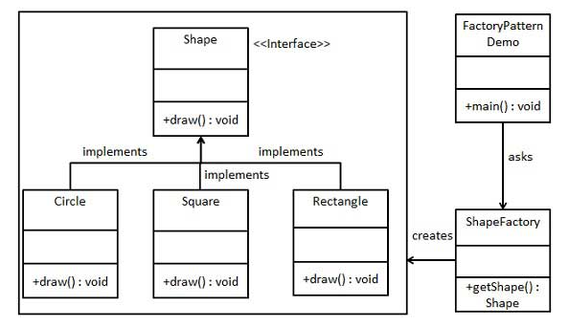
FACTORY PATTERN Example

Slide 7
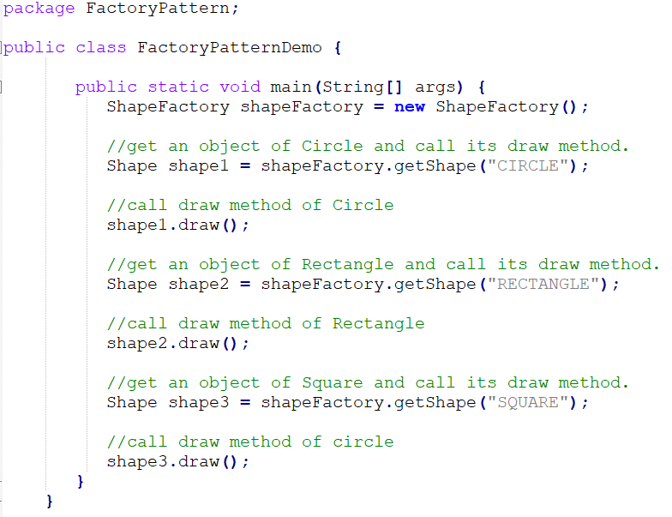
FactoryPatternDemo

Slide 8
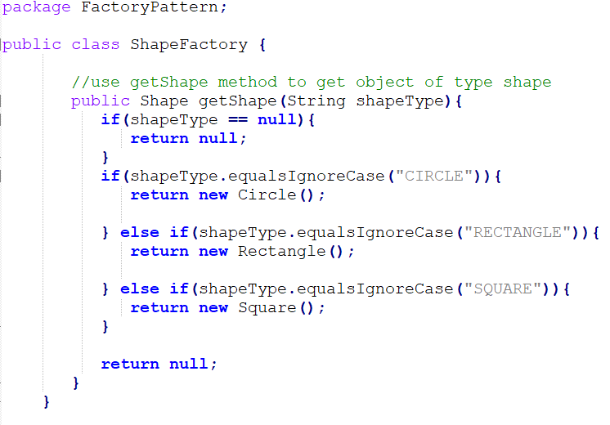
ShapeFactory Code

Slide 9
What to do?
We will code the necassary classes with Java.
First, we need to start with «shape» default base class.
This class will have the all default specializifications for the shapes.
Then we need to create «Circle», «Square», and «Rectangle» classes.

Slide 10
What about UML?
Please try to see the relations between these classes, using objectAid plug-in of eclipse

